Slide 1
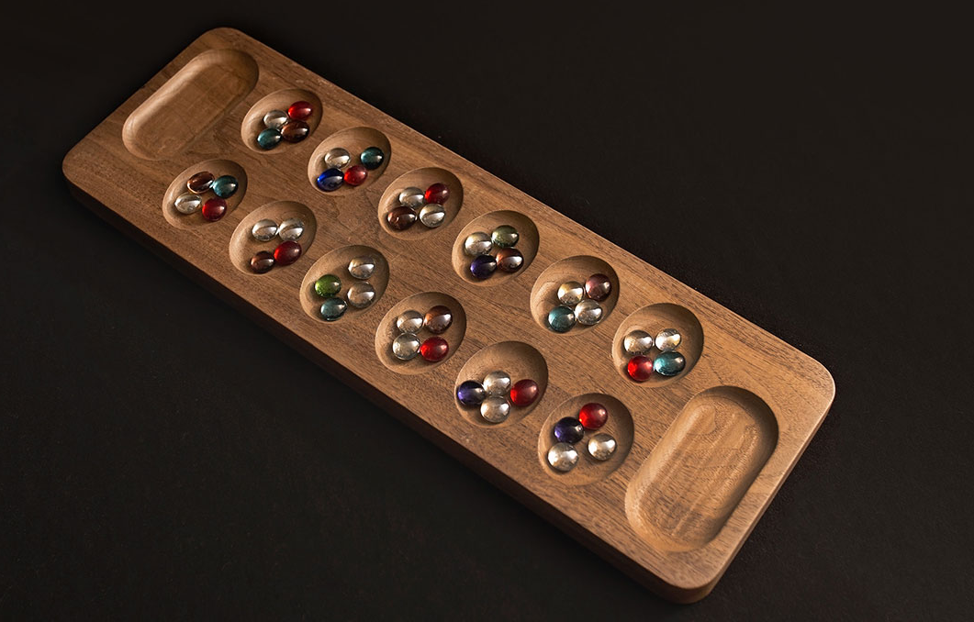
Mancala AI
By Colby Schexnayder, Alex Joslin, Sean Seever

Slide 2
Programming Language: C++
Familiar and easy to use!
Multiple libraries gave easy solutions to some issues.
Object-Oriented Design

Slide 3
Data structures
Board - represented as an integer array with 14 slots
4 4 4 4 4 4 <--- Index 8-13
Index 0 ---> 0 0 <--- Index 7
Index 1-6 ---> 4 4 4 4 4 4
States - generateChildren(Node)
Takes a Node as argument, generates children and puts them in a vector which is added to the tree.

Slide 4
Search Algorithms
Minimax with Alpha-Beta pruning
Implemented within the generation function
Only generates values as needed, when needed
Depending on who’s turn it was, alpha or beta would break from the recursion if the values were not important.
Maximum Depth
Allows the generation to continue down to 3 total turns (or 6 ply).
After reaching the target depth, it would return the heuristic value of the node.

Slide 5
Heuristics
Our Heuristic consists of 3 factors
H1 = opponent stones - AI stones
The value assigned is the (total number of opponent stones) - (total number of AI stones)
H2 = is there a situation where opponent stones can be captured
The value assigned is the number of stones that can be captured
H3 = pits with a high amount of stones are considered dangerous
The value assigned is 0 for 6 and below, 1 for 7, 2 for 8, 3 for 9 and above
HT = H1 + H2 - H3

Slide 6
Why? & Other software used
To generate the entire mancala tree would be practically impossible
We limit the depth to 6, otherwise the tree generation takes too long.
Alpha-Beta pruning saves on static evaluations and move generation. Therefore saving us time and memory.
Without Heuristics there is no AI
We built our application on Repl.it (an online IDE)
Allows us to log on and add code to it anytime want

Slide 7
Lessons Learned -Alex
Planning is crucial
Decide on the best data structure to represent to board
Know what classes and structures to use
Ignore features that are not important
KNOW THE AI TECHNIQUES WELL
Heuristics can be tricky
Trial and Error

Slide 8


